Slide 1
Fraud detection of bank accounts
Jinhui Shen
Special acknowledge to mentor
David Lara Arango

Slide 2
Agenda
Problem Overview
Data Source and Wrangling
Exploratory Data Analysis (EDA)
Preprocessing, Modeling and Evaluation Metrics
Comparison
Conclusion
Future Work

Slide 3
Problem Overview
This project aims to build a machine learning model for bank account fraud detection.
It can be used to alert the bank and minimize financial loss.
Fraud events are quite less compared to not fraud events.

Slide 4
Data Source
Kaggle dataset: Base.csv
Downloaded from https://www.kaggle.com/datasets/sgpjesus/bank-account-fraud-dataset-neurips-2022
Data covers information of fraud status, and applicant’s other information such as:
age
income
request country origin
housing and employment status
initial amount
risk score
proposed credit limit, etc.

Slide 5
Data Wrangling
Duplicated records check
Unique values check in categorical features
Negative values check in numeric features
`prev_address_months_count`, `bank_months_count`, `current_address_months_count` | missing value
`session_length_in_minutes`, `device_distinct_emails_8w` | missing value, all -1
`velocity_6h` | missing value, continuous, checked with data source author
`intended_balcon_amount` | missing value, initial deposit, continuous, checked with author
`intended_balcon_amount_negative` | categorical feature added, to show missing value imputed portion
`credit_risk_score` | continuous, rescaled

Slide 6
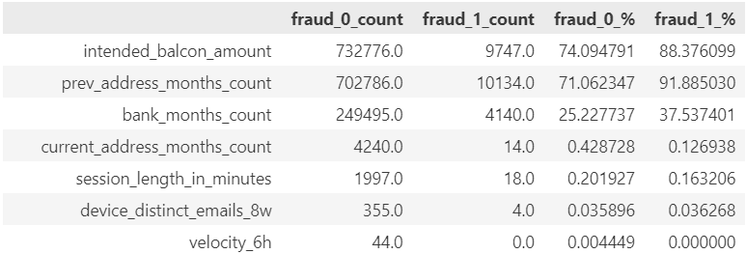
Data Wrangling
Missing values imputation
median imputation
<1%, dropped

Slide 7
Exploratory Data Analysis (EDA)
Class imbalance: fraud records only 1.1%
Categorical features: statistics summary, visualization of normalized count difference plots between classes
Numeric features: statistics summary, weighted histogram visualization and box plots between classes, pairplot and correlation matrix heat maps
`device_fraud_count`: no difference between classes, dropped.

Slide 8
Preprocessing for Modeling
One-hot encoding of not binary categorical features
Scale standardization of numeric features
Training and testing data set split, test size=0.3
Data resampling for class imbalance
The Synthetic Minority Oversampling Technique (SMOTE)
Under-sampling with RandomUnderSampler: best in performance
Under-sampling by removing Tomek’s links
Under-sampling by EditedNearestNeighbours

Slide 9
Modeling Methods
Classification modeling
Logistic Regression
Random Forest
K-Nearest Neighbor (KNN)
Gradient Boost
Stacking modeling
Neural network modeling

Slide 10
Evaluation Metrics
Accuracy score
Precision score
Recall score
F1 score
ROC-AUC score
PR-AUC score
false negative vs false positive

Slide 11
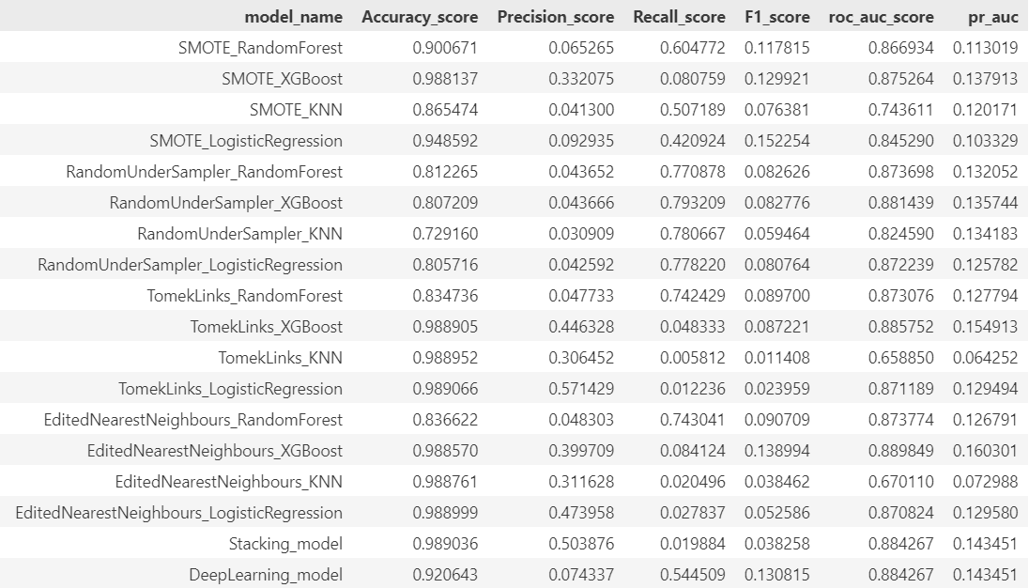
Modeling Results Comparison

Slide 12

Hyperparameters Tuning
For XGBClassifier with RandomUnderSampler re-sampling, RandomizedSearchCV found best parameters:
Evaluate the best model on the test set
As we want to detect all the frauds and lower false negative rate, recall score is more important here

Slide 13
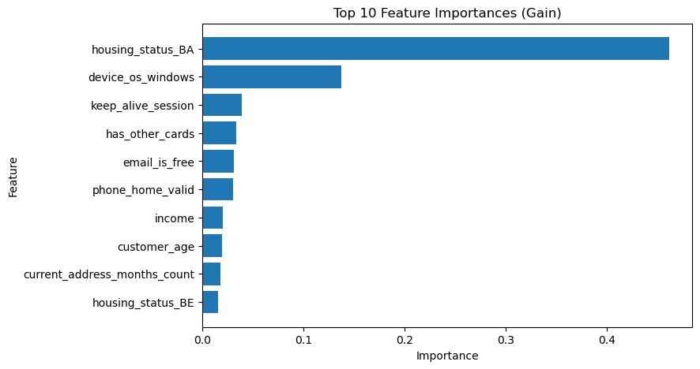
Feature Importance
In the best XGBoost model

Slide 14
Conclusion
Reducing false negative is more important to the nature of the banking fraud question
Accuracy score is not a good choice of metrics due to the type imbalance
RandomUnderSampler XGBoost modeling performed best and gave a recall score of 0.806
TomLinksUnderSampler_RegisticRegression perfomed best for precision score as 0.571, although it’s not our focus
Stacking modeling and deep learning model was also tried, but didn’t improve performance a lot, probably due to data limitation and imbalanced data

Slide 15
Future work
More data will be collected, or data sets will be added to improve modeling results
Real time prediction system to alert bank account activities.

Slide 16
Business Impact
The model can catch most of the fraud bank account activities and help to minimize financial loss to banks.

